Slide 1


FRIDO @ GOLF COURSE–GURGAON
3D VIEWS
25:04:2026
Prepared By:
vertex
DELINEATE

Slide 2
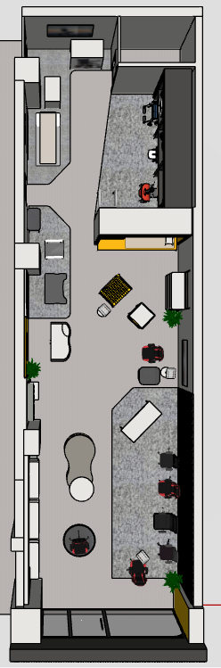
Prepared By:
vertex
DELINEATE

Slide 3
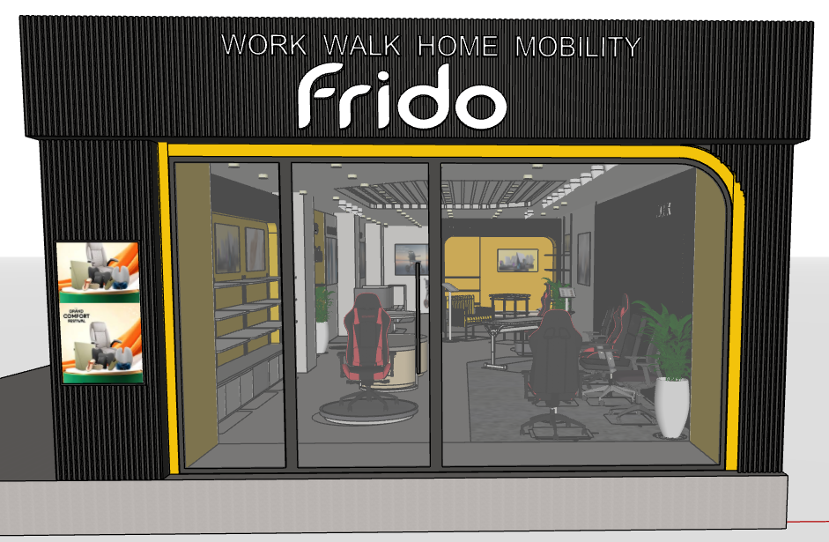
Prepared By:
vertex
DELINEATE

Slide 4

Prepared By:
vertex
DELINEATE

Slide 5
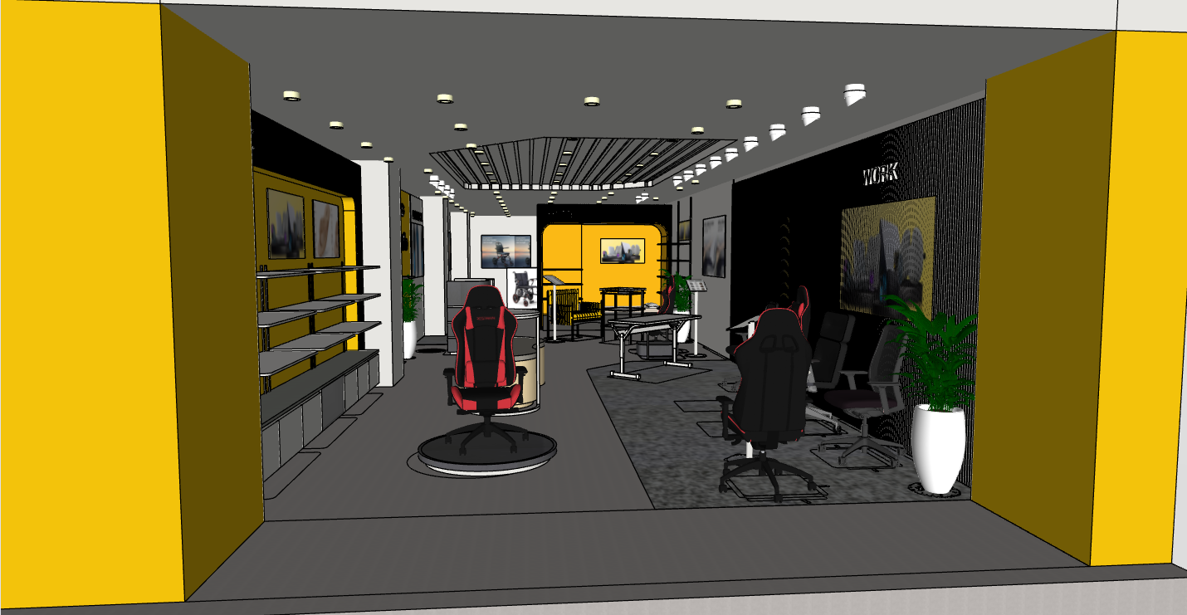
Prepared By:
vertex
DELINEATE

Slide 6
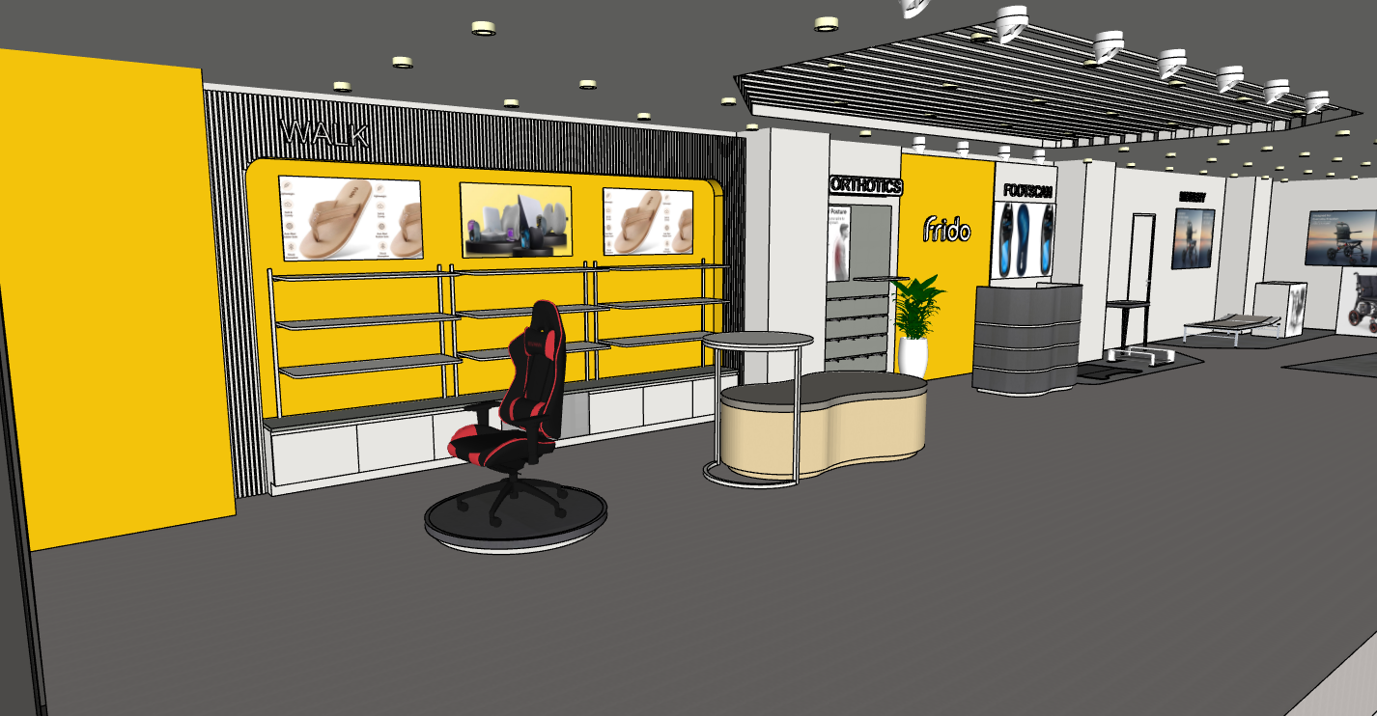
Prepared By:
vertex
DELINEATE

Slide 7
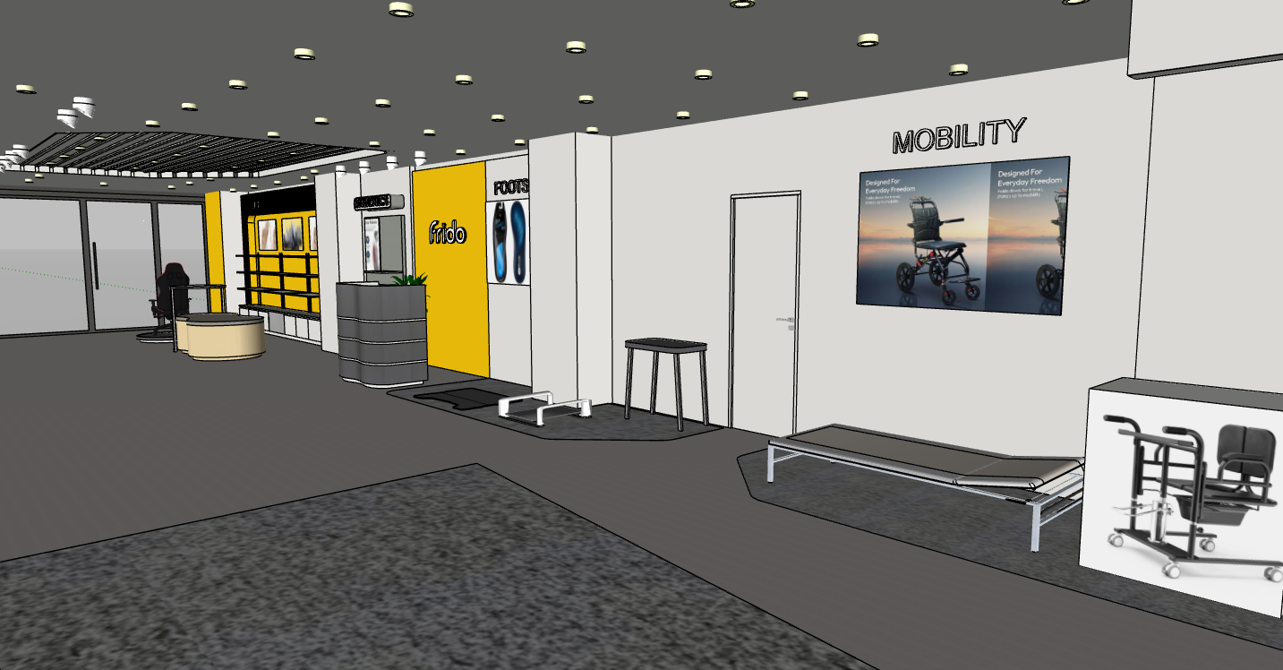
Prepared By:
vertex
DELINEATE

Slide 8
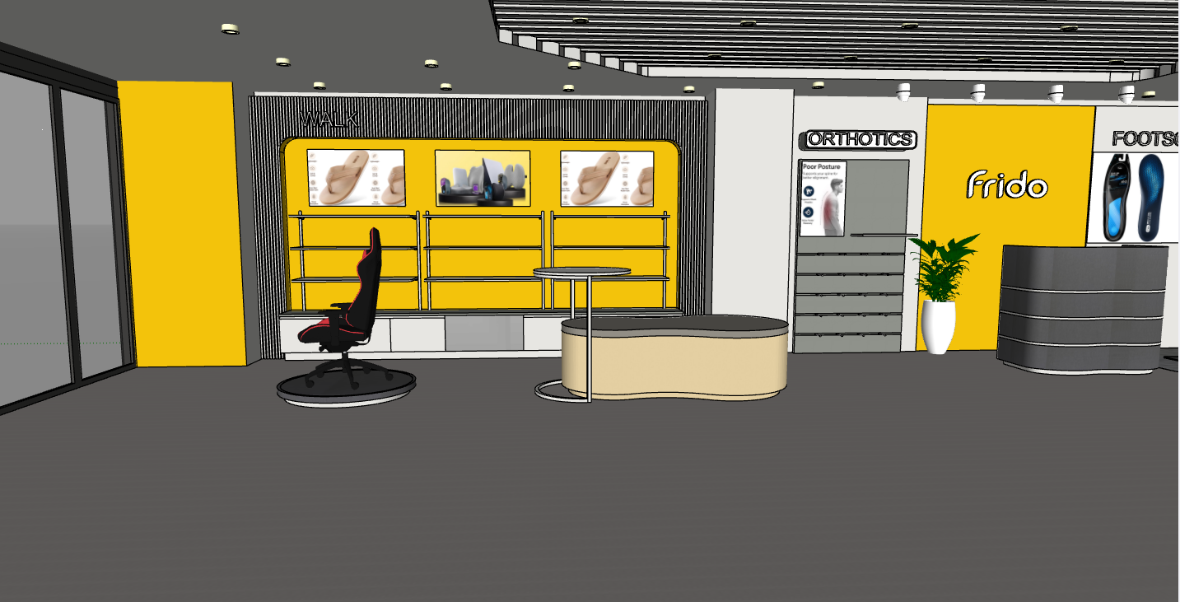
Prepared By:
vertex
DELINEATE

Slide 9
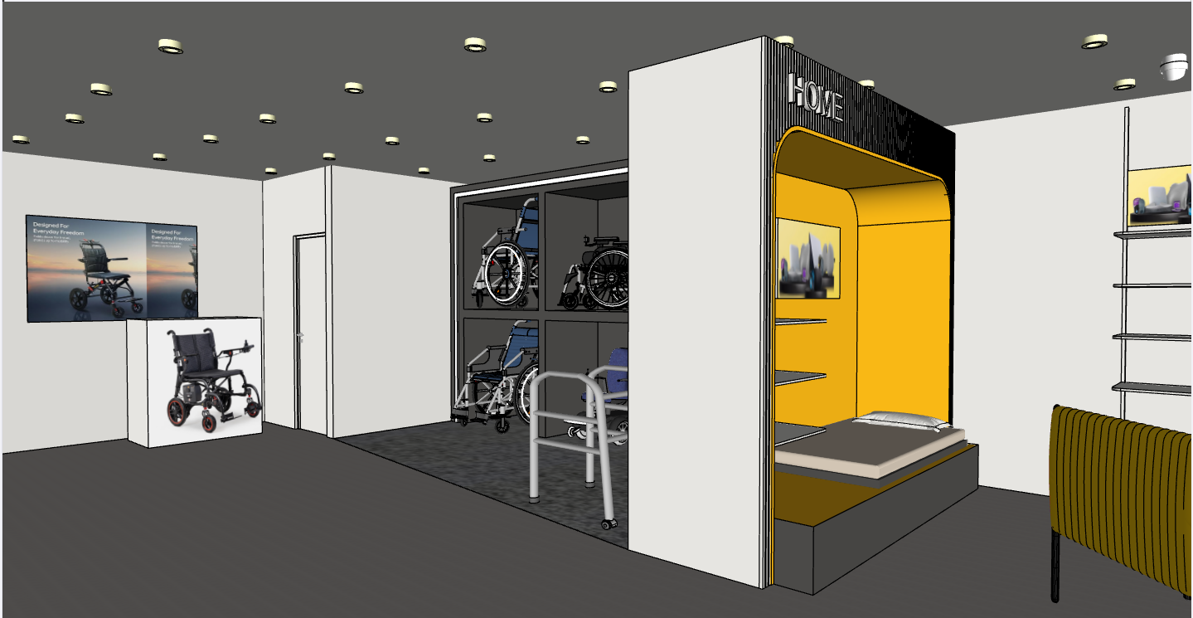
Prepared By:
vertex
DELINEATE

Slide 10
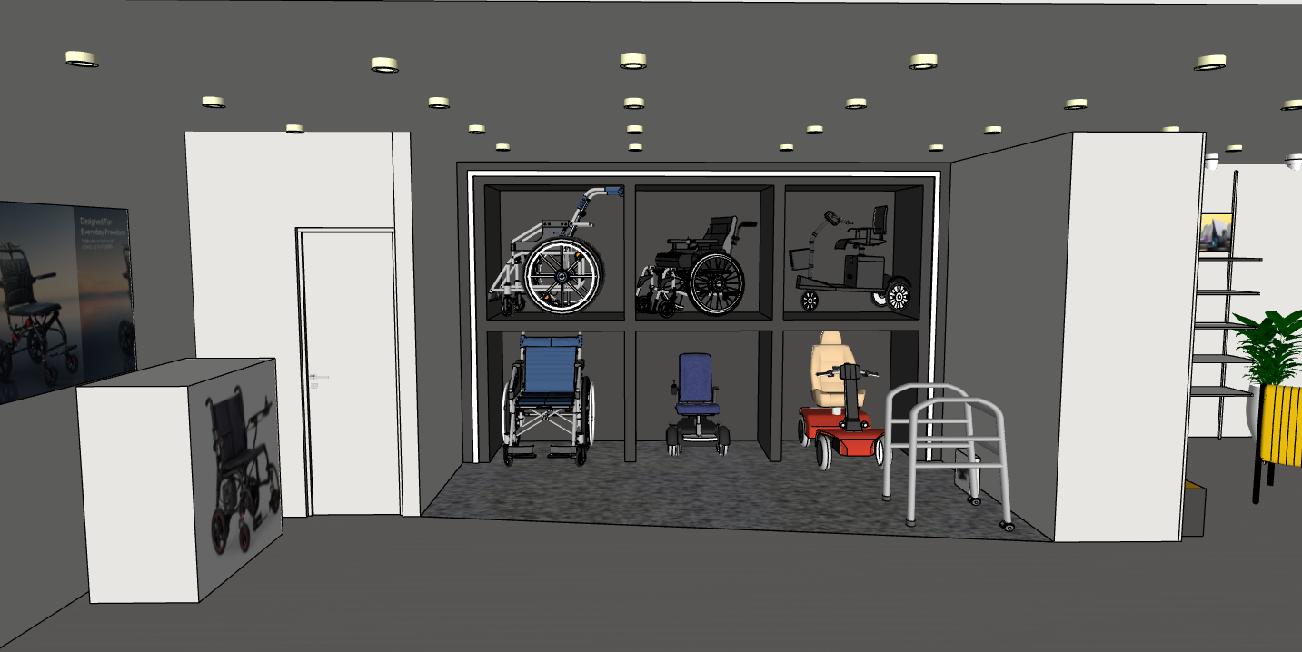
Prepared By:
vertex
DELINEATE

Slide 11
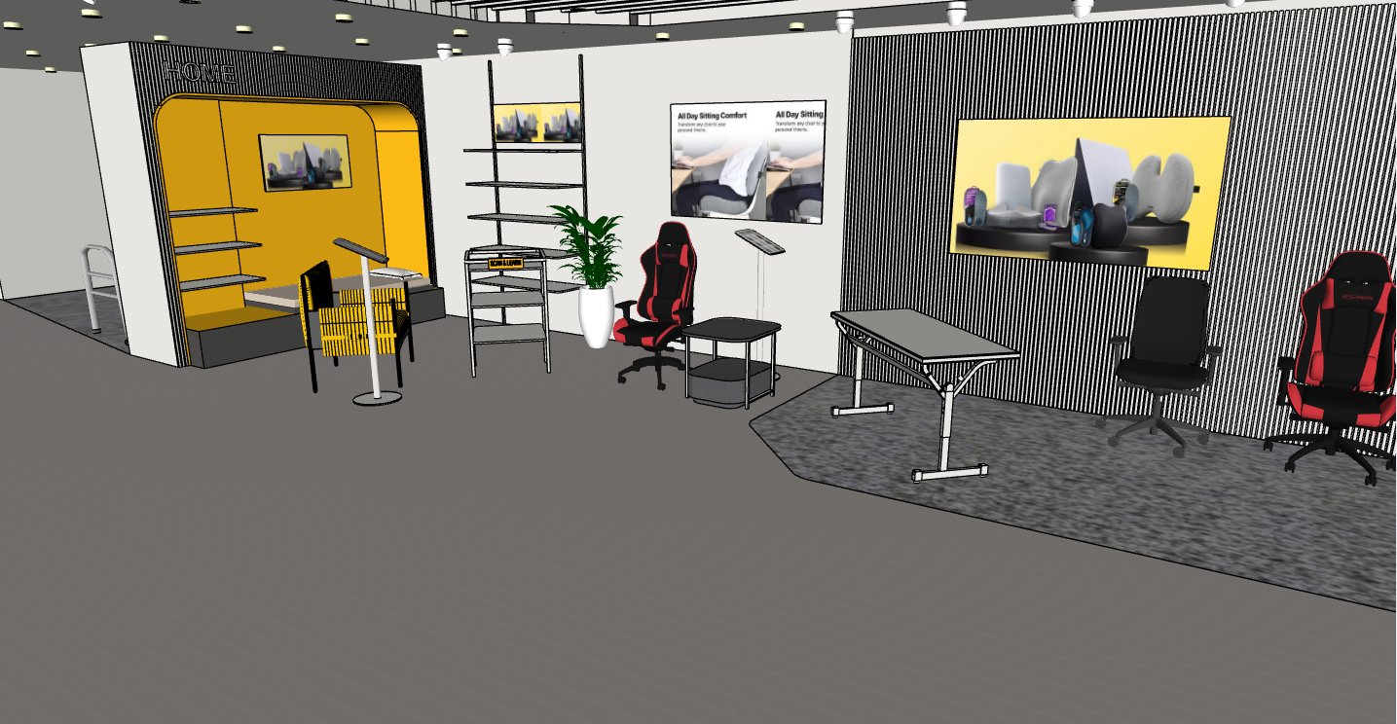
Prepared By:
vertex
DELINEATE

Slide 12
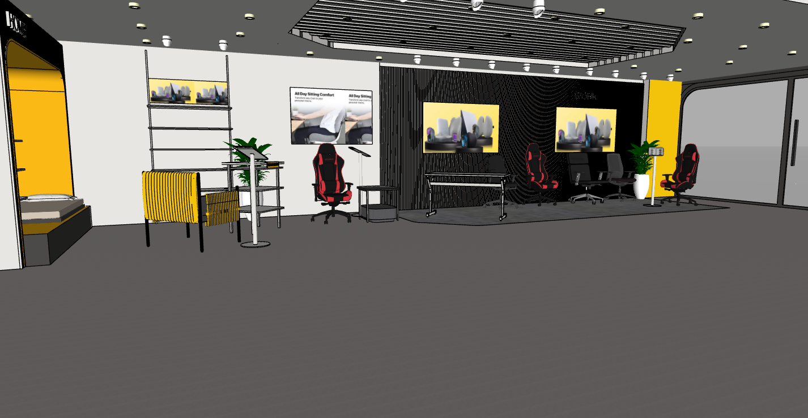
Prepared By:
vertex
DELINEATE

